Slide 1

Exploratory Data Analysis on AMCAT Data
Vaishnavi Voleti

Slide 2
About me
Hey there! I am Vaishnavi Voleti, an undergraduate in Computer Science Engineering ( AI & ML), currently I am in my third year of B.Tech.
I am passionate about leveraging technology to solve real-world problems and enthusiastic about the potential of data-driven decision-making.
I have participated in Smart India Hackathon(SIH) to apply theoretical knowledge in practical scenarios.
I am actively engaged in Machine Learning projects: Autism Spectrum Disorder Detection using Facial Images and City Power Consumption Prediction using statistical data. I employed Deep Learning models for accurate predictions.
You can find more about me on LinkedIn https://www.linkedin.com/in/vaishnavivoleti/

Slide 3
Objective:
This analysis focuses on extracting insights from the dataset, emphasizing the relationship between features and the target variable.
It aims to:
Identify trends within the data.
It explores the relationships between the features of the data.
Detect the anomalies in the data
Your Experience/Challenges working on Web Scraping – Data Analysis Project.
Dataset Description:
The dataset, provided by Aspiring Minds through the AMEO, focuses specifically on students with engineering backgrounds. The study primarily examines the employment outcomes of engineering graduates, using standardized scores from three distinct areas: cognitive skills, technical skills, and personality skills. In addition to the dependent variables related to employment outcomes, the dataset incorporates demographic features. It encompasses approximately 40 independent variables and consists of 4000 data points. These independent variables encompass both continuous and categorical characteristics. Each candidate in the dataset is uniquely identified.

Slide 4
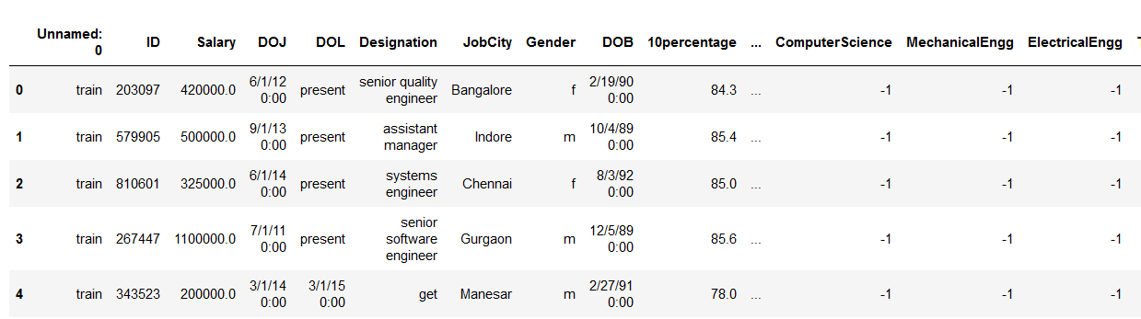
Dataset overview
Head of the dataset:
Shape of the data: (3998, 39)
Describing the data: Dataset has 10 float, 17 int and 12 object type features, with zero null values.

Slide 5
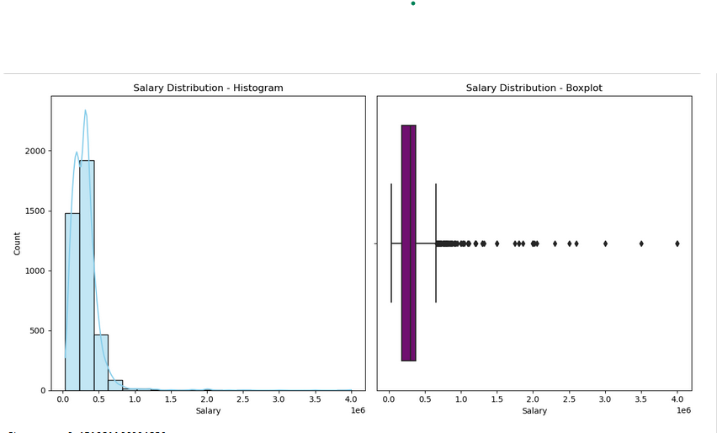
Univariate Analysis:
The distribution demonstrates positive skewness with a
value of 6.45. This suggests that a majority of salaries are
concentrated at the lower end, while a few instances
exhibit exceptionally high salaries.
A total of 109 outliers were detected, showcasing salaries
that significantly deviate from the general trend. Notable
examples include salaries of 1,100,000, 800,000, and
1,500,000.
Majority of the employees are male
Analysis indicates that roles such as Data Scientist, Senior Developer, and Technology Lead rank among the top 20 positions commanding higher salaries in IT firms. These positions often involve specialized skills, technical expertise, and leadership responsibilities, correlating with increased compensation.
Positions like Branch Manager, Research Scientist, and Sales Account Manager prominently contribute to salary levels within the IT industry. This highlights that leadership roles and specialized expertise play a significant role in determining salaries.

Slide 6
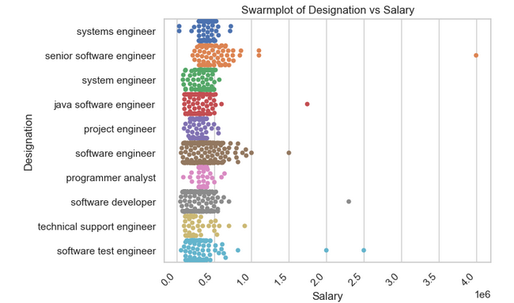
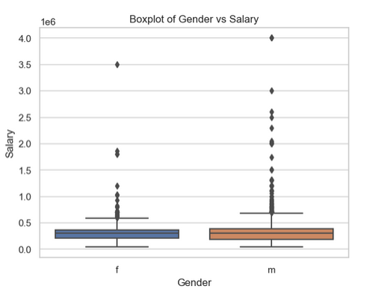
Bivariate Analysis:
Software engineers with senior titles tend to earn more. This is likely because they
have more experience and expertise than those with more junior titles. For example,
in the plot, senior software engineers earn around $150,000 per year, while software
engineers earn around $100,000 per year.
There is a lot of variation in salary within each designation. For example, some software
engineers earn less than $75,000 per year, while others earn more than $200,000
per year. This variation is likely due to a number of factors, such as
experience, education, location, and employer
There is a statistically significant difference in salary between men and women. The
median salary for men is higher than the median salary for women. The interquartile
range (IQR) for men is also wider than the IQR for women, which suggests that there is
more variability in salaries for men.
The distribution of salaries is skewed for both men and women. This means that there are more
people at the lower end of the salary range than at the higher end.There are outliers in both
groups. These are data points that fall outside the 1.5 IQR whisker range. Outliers can be caused by a
number of factors, such as measurement error or extreme values.
.

Slide 7
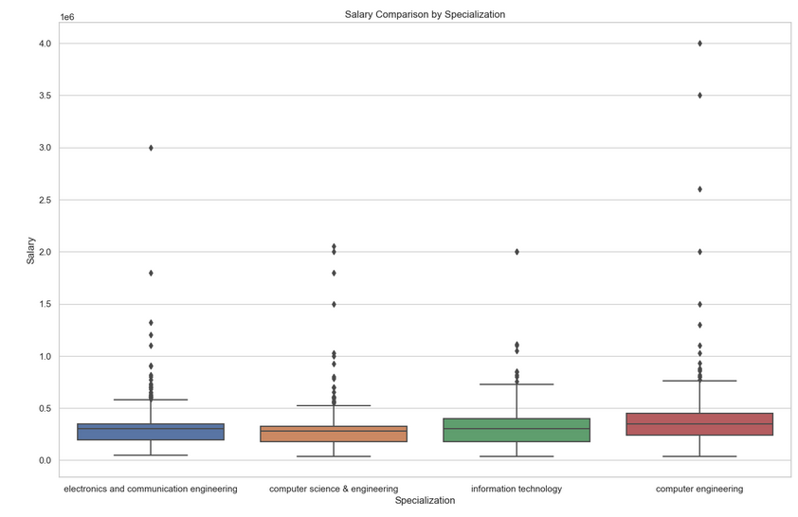
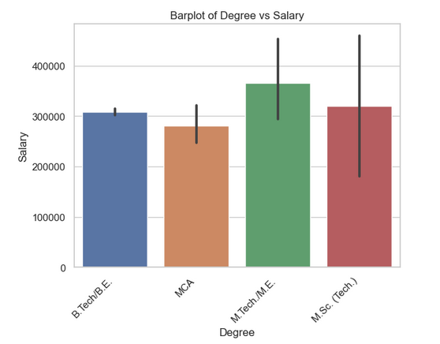
There is a significant difference in salary medians between the specializations. The highest median salary is for information technology, at around $35,000 per year, while the lowest median salary is for electronics and communication engineering, at around $20,000 per year.
The salary distributions for all specializations are positively skewed. This means that there are more people at the lower end of the salary range than at the higher end.
There is a positive correlation between degree and salary. This means that people with higher degrees tend to earn more money than people with lower degrees.
The salary distribution is skewed for all degrees. This means that there are more people at the lower end of the salary range than at the higher end.

Slide 8
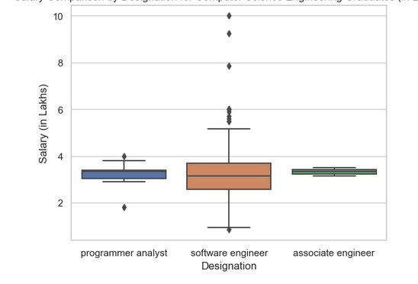
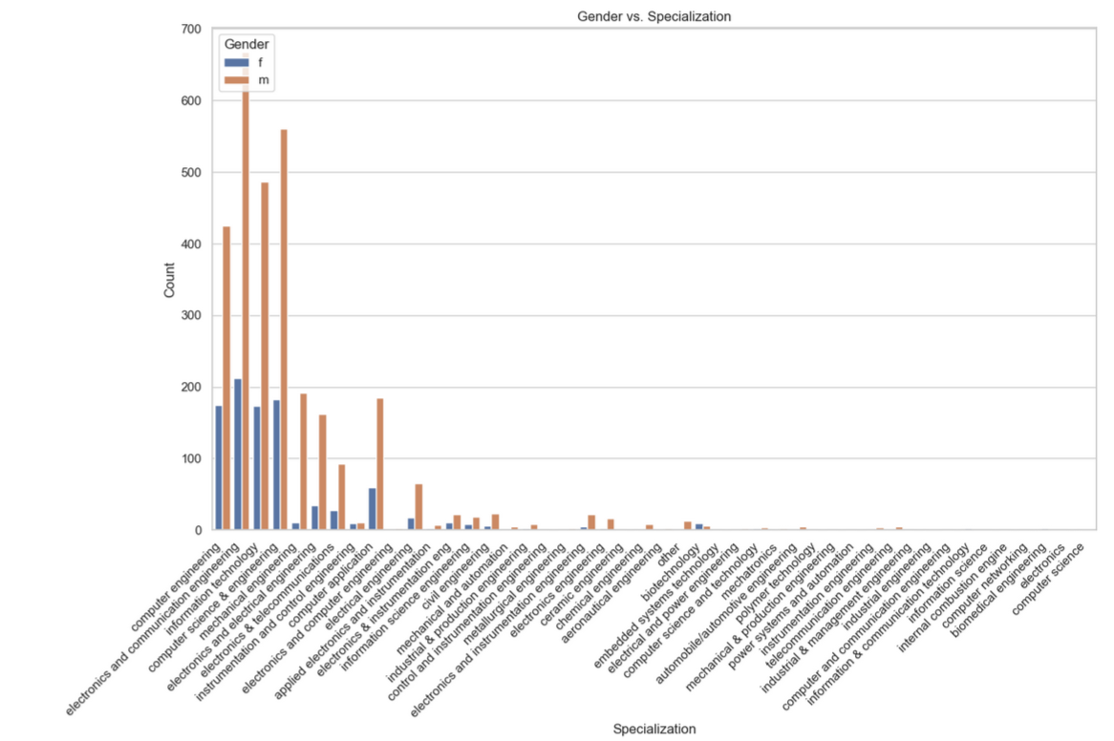
Research Questions:
From the analysis, after doing Computer Science Engineering if you take up jobs as a Programming
Analyst, Software Engineer and Associate Engineer you can earn up to 2.-3 lakhs as a fresh graduate.
Nevertheless, there was a lack of available data to substantiate the claim that opting for a role as a
Hardware Engineer after completing Computer Science Engineering could result in earning between
2.5 to 3 lakhs as a recent graduate.
From this distribution, we can say male are doing more specialization compared to female

Slide 9
Conclusion
The salary distribution displays some skewness, indicating variations in compensation levels among individuals. By utilizing histogram and boxplot visualizations, we identified outliers that warrant further investigation.
In the bivariate analysis, correlations between salary and specific features such as 'Quant,' 'Logical,' 'English’ were revealed. Conversely, features like 'Computer Science,' 'ID,' and 'CollegeTier' demonstrated negative correlations with salary.
We subjected The Times of India's assertion regarding salary expectations for recent graduates in Computer Science Engineering to scrutiny using the dataset. Additionally, we delved into the connection between gender and specialization preferences.
Gender does not have a significant impact on income; however, women tend to receive salaries below the overall average.
Most of the people designation is Software Engineer.

Slide 10

THANK YOU

